Slide 1
About Java
Java is a general purpose programming language.
Invented by James Gosling.
Java was released in May, 1995.
Derives its syntax from C and C++.
Java is provided as 3 different editions
Java SE
Java EE
Java ME

Slide 2
Java SE (Standard Edition)
In vague terms this is the core java language.
Provides language features, core API (Application Programming Interface) related to IO Streams, Networking, Data Structures and more.
It comes with Java compiler, JVM (Java Virtual Machine).
Used to build Console Applications and Frame Based Applications (Desktop Applications).

Slide 3
Java EE (Enterprise Edition)
Commonly known as Advanced Java.
Used to build web applications web services, and enterprise applications.
Major topics are –
Servlets
JSP (Java Server Pages)
Java Mailing
MVC Frameworks – Struts, Hibernate

Slide 4
Java ME (Micro Edition)
Used to develop software which can be embedded into micro devices such as mobile phones.
Lost popularity due to rise of android phones.

Slide 5
Features of Java
Robust – checks for potential errors both at compilation time and runtime.
int i, j;
i += j; // Use of unassigned local variable
int arr[10];
arr[10] = 100; // accessing element outside
// bounds

Slide 6
Features of Java (Contd.)
Platform Independence –
Write Once, Run Anywhere (WORA)
Java programs are NOT compiled to native code but and instead they are compiled to Byte Code.
Once a Java program is compiled to byte code, then it can be run on any platform where JVM is available

Slide 7
Hello Java!
class Hello {
public static void main(String[] args) {
System.out.println(“Hello Java!”);
}
}

Slide 8
Primitive Data Types in Java
Data type | Size (bytes) | Range
byte | 1 | -128 to 127
short | 2 | -32768 to 32767
int | 4 | -2147483648 to 2147483647
long | 8 | -9223372036854775808 to 92233720368547758087
float | 4 | 1.7e-308 to 1.7e+308
double | 8 | 3.4e-038 to 3.4+038
boolean |  | true or false
char | 2 | Supports Unicode

Slide 9
Escape Sequence Characters
Character | Meaning
\’ | Single Quote
\” | Double Quote
\\ | Single Backslash
\r | Carriage Return
\n | New Line
\t | Tab Space
\b | Backspace

Slide 10
Arithmetic Operators
Operator | Meaning
++ | Increment
-- | Decrement
* | Multiplication
/ | Division
% | Modulus
+ | Addition
- | Subtraction

Slide 11
Relational Operators
Operator | Meaning
== | Equal To
> | Greater Than
< | Less Than
<= | Less Than or Equal To
>= | Greater Than or Equal To
!= | Not Equal To

Slide 12
Logical Operators
Operator | Meaning
& | AND
| | OR
^ | XOR
|| | Short Circuit OR
&& | Short Circuit AND
! | Unary NOT

Slide 13
Bitwise Operators
Operator | Meaning
~ | Ones Compliment
& | Bitwise AND
| | Bitwise OR
^ | Bitwise XOR
<< | Shift Bits left by N times, Filling 0 on right
>> | Shift Bits right by N times, Filling sign bit on left
>>> | Shift Bits right by N times, Filling 0 on left

Slide 14
If-else in Java
if (percentage >= 90) {
grade = ‘A’
} else if (percentage >= 80) {
grade = ‘B’;
} else if (percentage >= 70) {
grade = ‘C’;
} else {
grade = ‘F’;
}

Slide 15
Switch in Java
switch (quantity) {
case 1:
price = 50;
break;
case 2:
price = 90;
break;
default:
price = (quantity * 40);
}
In Java, we can even compare Strings using a switch statement.
In such a case, the expression must evaluate to a String.

Slide 16
While loop in Java
i = 0;
while (i < length) {
sum += arr[i];
++i;
}
The condition must evaluate to a boolean value.

Slide 17
For loop in Java
for (int i = 0; i < length; ++i) {
sum += arr[i];
}
We can declare variables inside the loop
The scope of such variables is the body of the for loop.

Slide 18
Do-While loop in Java
i = 0;
do {
sum += arr[i];
++i;
} while (i < length);

Slide 19
Reading input using Scanner
Scanner is a class which is used to take input from the users. The following code snippet demonstrates this -
Scanner s = new Scanner(System.in);
int i = s.nextInt();
long l = s.nextLong();
double d = s.nextDouble();
String str = s.nextLine();

Slide 20
java.util.Scanner
The Scanner class is available in the java.util package.
We must write an import statement to make the Scanner available to the current program.
import java.util.Scanner;
In NetBeans, this is done easily by right-clicking and selecting “Fix Imports”.
This is just like importing libraries.

Slide 21
Where did println() come from?
Having learnt that we need to import Scanner from a different package, this must raise a question as to where our System.out.println() come from ?
For every Java program, the package, java.lang is automatically imported.
This is where the basic printing statements and Math functions come from.

Slide 22
Declaring Arrays in Java
int[] arr; // Declaring an array
arr = new int[10]; // Creating array of size 10
// Or we can do it all in one step
int[] array = new int[10];
// Dynamic sized
int[] arr = new int[n];

Slide 23
Using Arrays in Java
We use arrays in Java just as we do in C. Only the declaration part varies.
System.out.println(arr[0]);
Arrays in Java always know their length. We can get the array length by using the length property.
System.out.println(arr.length);
// Prints length of array
Accessing an element out of arrays bounds throws ArrayIndexOutofBoundsException
System.out.println(arr[-1]);

Slide 24
Creating 2D arrays in Java
You can create a double dimensional array using two square brackets. Eg.
int[][] arr = new int[5][6];
int[][] arr = new int[2][2];
int[][] arr = new int[10][n];
Elements are accessed just as in C.
System.out.println(arr[0][1]);
Once the memory is allocated (using new), the elements of an array are initialized to their default values.

Slide 25
Enhanced for loop in Java
Java provides a looping construct called the enhanced for loop or for-each loop specially to iterate over arrays and collections.
It takes each value from an array and assigns it to the loop variable.
Loop ends when there are no further elements in the array.
int[] array = new int[10];
for (int num : array) {
System.out.println(num); // Prints all numbers
}

Slide 26
Disadvantages of enhanced for loop
We cannot change an element in the actual array. This is because the value is copied to the loop variable. So, it is a read-only iteration.
We cannot skip an element in the iteration process. We must look at each and every element in the array.
We cannot add new elements to the collection which is used in the enhanced for loop. This throws ConcurrentModificationException.

Slide 27
Labelled loops in Java
We can assign labels each loop in java.
Labels are ordinary names followed by a colon.
Becomes very handy when we want to break out of the outer loop from the inner loops.
To do that, we use labelled break and labelled continue.
Loop:
for (int i = 0; i < arr.length; ++i) {
break Loop;
}

Slide 28
Labelled loops in Java
int[][] arrays = new int[5][5];
// code
OuterLoop:
for (int[] array : arrays) {
InnerLoop:
for (int num : array) {
if (num == -1) {
break OuterLoop;
}
}
}

Slide 29
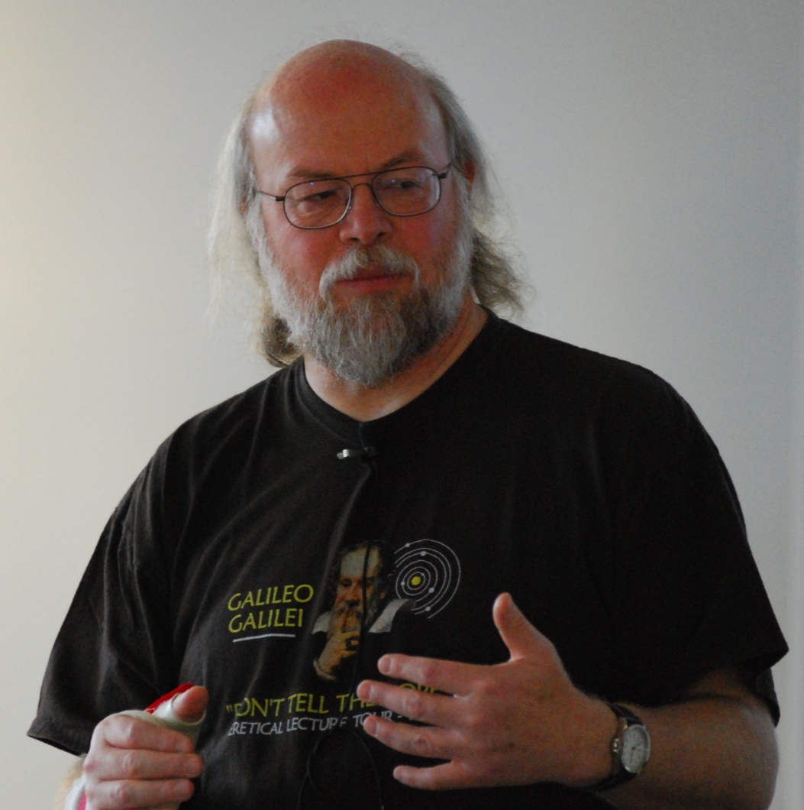
Thank you !

